Slide 1

Krushaware – revolution for farmers
Project Presentation
By
Enrollment Number Student Name
MITU22BTCS0599 Prem Urkude
MITU22BTCS0906 Tanmay Khedekar
MITU22BTCS1020 Yash Tagunde
MITU22BTCS0859 Sudip Konde
Guided By
Dr.Arvind Jagtap
Department of Computer Science & Engineering, MITSoC, Loni Kalbhor

Slide 2
Outline
1 INTRODUCTION
2 CONCEPTS AND METHODS
3 LITERATURE SURVEY
4 PROJECT PLAN
5. SOFTWARE REQUIREMENT SPECIFICATION
6 RESULTS
7 SOFTWARE TESTING
8 CONCLUSION AND FUTURE WORK
BIBLIOGRAPHY
ANNEXURE A: List of Publications and Research Paper (In its Original formats)
ANNEXURE B: Plagiarism Report
Department of Computer Science & Engineering, MITSoE, Loni Kalbhor

Slide 3
1. Introduction
The “Krushaware – revolution for farmers” app is a revolutionary digital platform designed to address the unique challenges and needs of farmers, with a focus on improving their agricultural practices, livelihoods, and overall well-being. This innovative application harnesses the power of technology to empower farmers and enhance their efficiency, productivity, and sustainability in farming activities.
Our app will provide Government Schemes That app serves as a repository of information about government agricultural schemes, subsidies, and support programs. It guides farmers through the application process, ensuring they benefit from available resources.
Weather and Climate Information: Farmers receive real-time weather updates and climate-related data to help them plan their farming activities, mitigate risks, and adapt to changing environmental conditions
Department of Computer Science & Engineering, MITSoE, Loni Kalbhor

Slide 4
2. Problem Statement
A farmer is a backbone of nation for raising food or raw need of human being, who needs technical support to overcome traditional planning for crop, unpredictable weather and fertilizer recommendation and awareness of government policies because they are not having guaranteed returns due to which they are failing to plan good life.
Department of Computer Science & Engineering, MITSoE, Loni Kalbhor

Slide 5
3. Objectives
Empower Farmers with Knowledge: Educate and empower farmers with essential agricultural knowledge, including crop management, pest control, and sustainable farming practices.
Access to Government Support: Streamline access to government agricultural schemes, subsidies, and support programs, ensuring farmers benefit from available resources.
Nutrient Management: Assist farmers in making informed decisions about fertilizer and nutrient management, aiming to optimize crop yields, minimize costs, and reduce environmental impact.
Mitigate Climate and Weather Risks: Provide real-time weather and climate information to help farmers plan and adapt to changing conditions, reducing weather-related risks
Environmental Sustainability: Encourage responsible farming practices that protect the environment, promote soil health, and reduce the use of harmful chemicals.
Department of Computer Science & Engineering, MITSoE, Loni Kalbhor

Slide 6
4. Concepts and Methods
1. Crop Management :
Concept: Empowering farmers with tools to manage their crops efficiently and fertilization management.
Method: Farmers can input information about their crops, and the app will recommend proper fertilizers.
2. Real-time Weather and Climate Information:
Concept: Providing farmers with local weather and climate conditions.
Method: The app integrates real-time weather data and sends alerts and recommendations based on current conditions
3. Government Support:
Concept: Simplifying access to government agricultural schemes, and support programs.
Method: The app provides information, application forms, and assistance in navigating government support channels.
Department of Computer Science & Engineering, MITSoE, Loni Kalbhor

Slide 7
5. Literature Survey
The literature survey for a project focusing on the development of the " Krushaware – revolution for farmers " app would involve researching existing literature and studies related to agriculture, farming technology, and mobile applications designed to support farmers. Here are some key areas to explore in your literature survey:
Weather and Climate Information :
Study the importance of weather and climate information for agriculture and the impact of accurate forecasting on crop management.
Explore the use of mobile apps to deliver real-time weather data to farmers.
Government Support :
Investigate the challenges farmers face in accessing government agricultural schemes and subsidies.
Explore the role of technology in simplifying the application process and increasing the uptake of government support.
Sustainable Farming Practices:
Review literature on sustainable and eco-friendly farming practices and the role of technology in promoting such practices.
Study the environmental and economic benefits of sustainable agriculture
Department of Computer Science & Engineering, MITSoE, Loni Kalbhor

Slide 8
6. Tools and Languages
We have used Python with the Tkinter library (often stylized as "tkinter") is a popular combination for developing graphical user interfaces (GUIs). Tkinter is the standard GUI library for Python and provides a set of tools and widgets for creating windows, dialog boxes, buttons, labels, and other GUI elements. It allows you to build desktop applications with user interfaces that users can interact with. Here's an overview of Python with Tkinter
Tkinter Basics:
Tkinter is included in the standard Python distribution, so you don't need to install additional libraries to use it.
It is a cross-platform library, meaning that applications developed with Tkinter can run on Windows, macOS, and various Linux distributions without modification.
Organize Code: As your Tkinter app grows, organizing our code into separate modules or classes can help maintainability.
We also used Adalo a low code app development platform that simplifies the process of creating custom mobile and web applications. It offers a visual, drag-and-drop interface for designing app components, databases, and user interfaces
Department of Computer Science & Engineering, MITSoE, Loni Kalbhor

Slide 9
7. Process and Architecture
The process and architecture of the " Krushaware – revolution for farmers " project involve a enhance agricultural practices approach to achieve the objectives. Here is an overview of the process and architecture:
Project Planning:
Define the project's purpose and objectives.
Identify the target audience (farmers) and their specific needs.
Content Development:
Details about government schemes and grants
Real-time weather forecasts specific to the farmer's location.
User Interface (Optional):
Develop a user-friendly software interface or graphical user interface (GUI) to enable users to Integrate data from weather APIs and refresh periodically.
Practical Projects:
These projects aim to enhance the app's usefulness and address practical farming challenges.
Department of Computer Science & Engineering, MITSoE, Loni Kalbhor

Slide 10
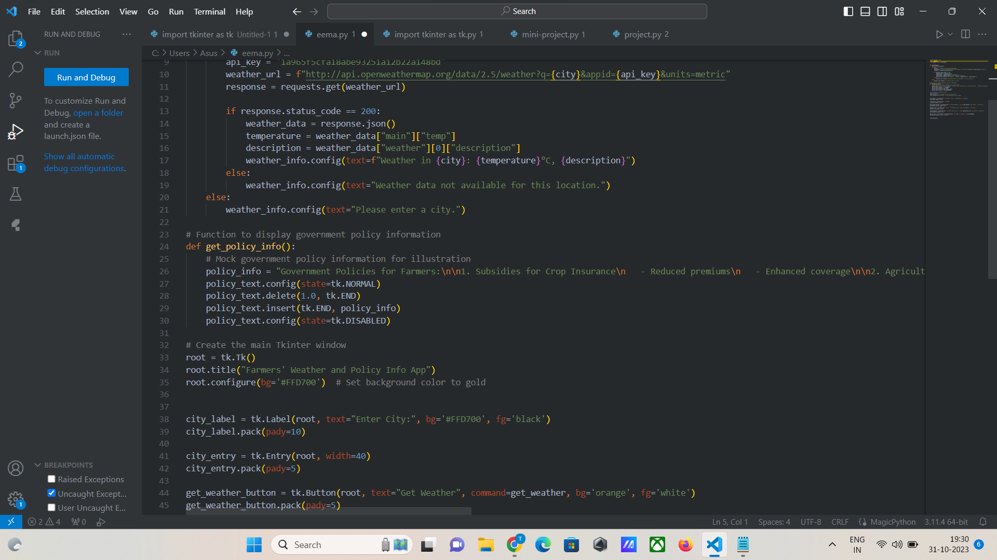
8. Implementation
Department of Computer Science & Engineering, MITSoE, Loni Kalbhor

Slide 11
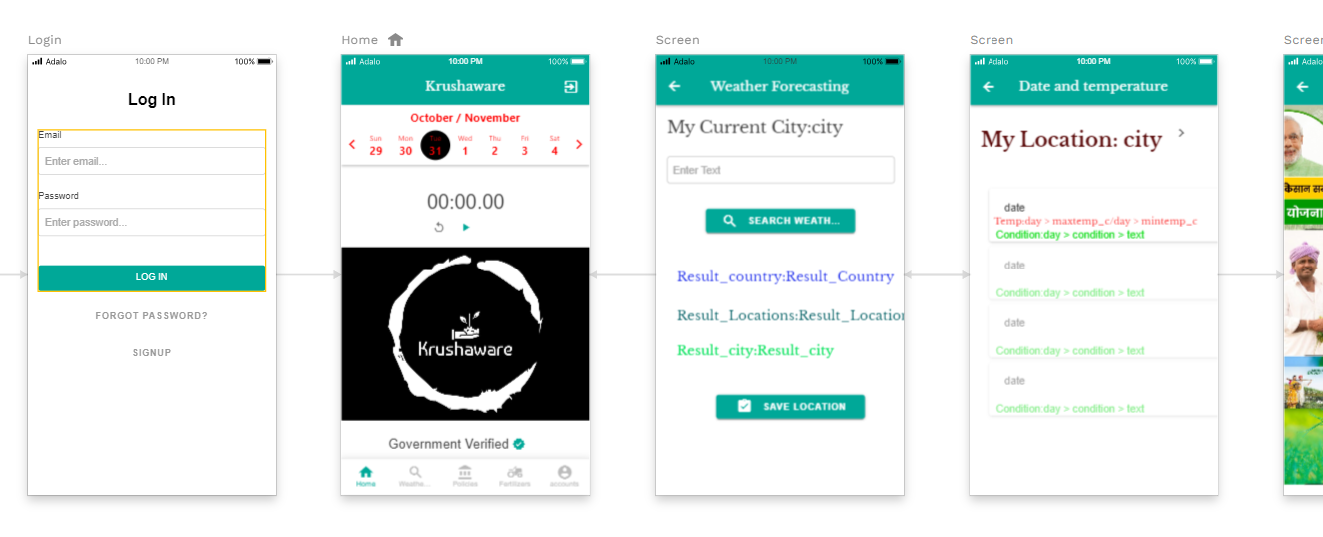
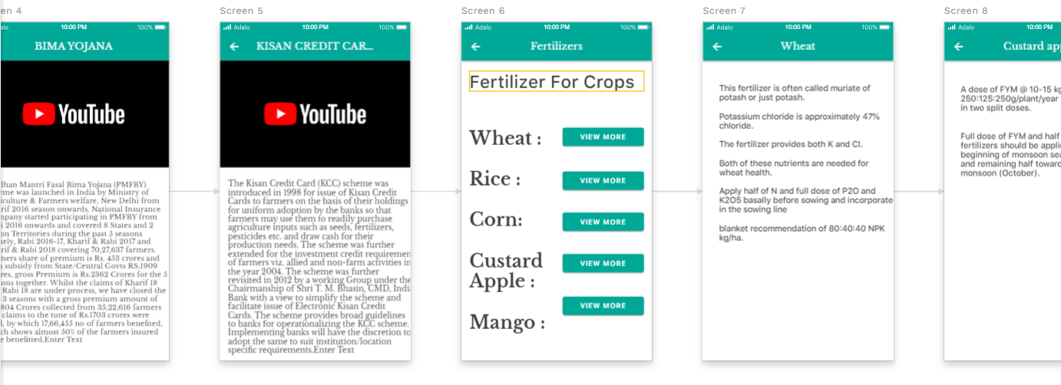
9. Results
Department of Computer Science & Engineering, MITSoE, Loni Kalbhor

Slide 12
10. Conclusion and Future Work
Conclusion:
In conclusion, the “Krushaware – revolution for farmers ” app has effectively bridged the gap between farmers and government schemes, offering a centralized platform where farmers can access information and apply for various agricultural support programs. By providing real-time updates and detailed documentation on government initiatives
The app has not only streamlined access to government schemes but also provided valuable weather forecasting, contributing significantly to the well-being and prosperity of farmers. It has the potential to continue being a transformative force in agriculture, empowering farmers with the knowledge and support they need to thrive in an ever-changing environment.
Future Work:
Enhance data analytics and machine learning.
Improve weather forecasting accuracy.
Expand market access and support more languages.
Focus on sustainability and eco-friendly practices..
Strengthen government partnerships .
Department of Computer Science & Engineering, MITSoE, Loni Kalbhor

Slide 13
References
[1] F. Jia and L. Z. Kong, “Intrusion Detection Algorithm Based on Convolutional Neural Network,” "Beijing Ligong Daxue Xuebao/Transaction Beijing Inst. Technol., vol. 37, no. 12, pp. 1271–1275, 2017, doi: 10.15918/j.tbit1001-0645.2017".12.011.
[2] L. Mohammadpour, T. C. Ling, C. S. Liew, and C. Y. Chong, “A Convolutional Neural Network for Network Intrusion Detection System,” "Proc. Asia-Pacific Adv. Netw., vol. 46, no. 0, pp. 50–55", 2018.
[3] U. Gur Çekmez et al., “Derin Ö˘ grenme ile A˘ g Anomali Tespiti Network Anomaly Detection with Deep Learning Ozgur Koray Sahingoz,” 2018, pp. 1–4.
[4] A. Chawla, B. Lee, S. Fallon, and P. Jacob, “Host Based Intrusion Detection System with Combined CNN/RNN Model,” "Lect. Notes Comput. Sci. (including Subser. Lect. Notes Artif. Intell. Lect. Notes Bioinformatics), vol. 11329 LNAI", pp. 149–158, 2019.
[5] S. Naseer and Y. Saleem, “Enhanced network intrusion detection using deep convolutional neural networks,” "KSII Trans. Internet Inf. Syst., vol. 12, no. 10, pp. 5159–5178, 2018, doi: 10.3837/tiis.2018".10.028.
Department of Computer Science & Engineering, MITSoE, Loni Kalbhor

Slide 14
Thank You
Department of Computer Science & Engineering, MITSoE, Loni Kalbhor

Slide 15
Questions
Department of Computer Science & Engineering, MITSoE, Loni Kalbhor

